Slide 1
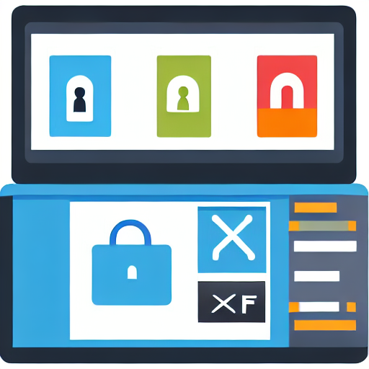
Foundations of Web Application Security
Web application security protects applications data and users from attacks
Secure by default minimize attack surface
Validate all user inputs
Implement least privilege access
Use encryption for data at rest

Slide 2

Common Threat Landscape
Common threat landscape outlines frequent attacks targeting web applications
Injection attacks exploit unsanitized input
Crosssite scripting undermines user trust
Broken authentication permits unauthorized access
Insecure direct object references expose sensitive data

Slide 3
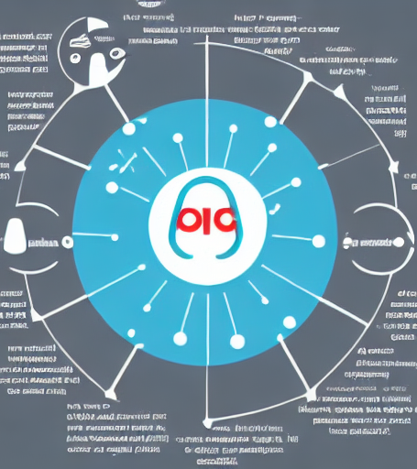
OWASP Top Ten Explained
The OWASP Top Ten is a prioritized list of the most critical web application security risks updated periodically to guide developers and security teams
Injection flaws untrusted data executed as code
Broken authentication session hijacking or credential misuse
Sensitive data exposure insecure storage or transmission
Security misconfiguration default or weak settings

Slide 4

Injection Attacks and Prevention
Injection attacks insert malicious code into input fields to exploit backend vulnerabilities
Validate and sanitize all user inputs before use
Use parameterized queries or prepared statements
Implement least privilege for database accounts
Employ web application firewalls to block malicious payloads

Slide 5

Authentication and Authorization
Authentication verifies identity authorization controls resource access
Use multi-factor authentication for stronger identity verification
Implement role-based access control for precise permissions
Employ least privilege principle to minimize risk
Regularly audit access logs to detect anomalies

Slide 6

Session Management Risks
Session management handles authentication states vulnerabilities arise when tokens are mishandled
Session hijacking through stolen or predictable tokens
Improper session expiration enables replay attacks
Weak regeneration allows fixation and unauthorized access
Lack of secure cookie flags exposes sessions to sniffing

Slide 7
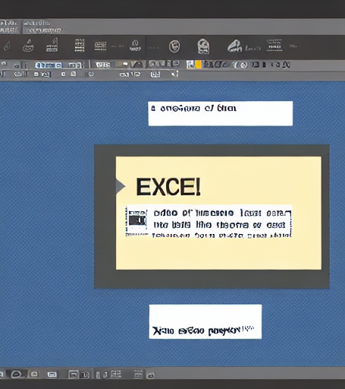
Cross Site Scripting Prevention
CrossSite Scripting XSS is a vulnerability where attackers inject malicious scripts into web pages viewed by others Prevention relies on input validation output encoding and security policies
Validate and sanitize all user inputs
Encode outputs to neutralize scripts
Deploy a robust Content Security Policy
Use frameworks that autoescape HTML

Slide 8

Secure File Upload Practices
Secure file upload ensures only intended safe files reach the server preventing malicious code execution and data breaches
Validate file type with MIME checks
Enforce strict file size limits
Store uploads outside web root
Scan for malware before processing

Slide 9

Data Protection in Transit
Data protection in transit encrypts data during transmission
Use TLSSSL to secure HTTP traffic
Implement Perfect Forward Secrecy PFS
Validate certificates to prevent MITM attacks
Regularly rotate and update cryptographic keys

Slide 10

Encryption at Rest Strategies
Encryption at rest safeguards stored data against unauthorized access
Use strong rotating key management practices
Implement databaselevel column and table encryption
Apply fulldisk encryption on servers and storage
Leverage hardware security modules HSMs for key storage

Slide 11
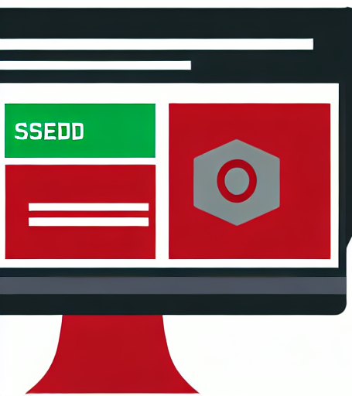
Input Validation Techniques
Input validation ensures user-supplied data meets expected format before processing preventing injection and other attacks
Use whitelisting over blacklisting for safer validation
Apply type length and format checks consistently
Encode output to neutralize malicious content
Enforce validation on both client and server sides

Slide 12

Error Handling and Logging
Secure error handling prevents information leakage while logs provide audit trails
Avoid revealing stack traces to users
Log errors with contextual data securely
Use generic error pages for end users
Implement centralized logging and monitoring

Slide 13

Security Testing Methodologies
Security testing evaluates a web apps resilience to threats and data breaches
Penetration testing simulates realworld attacks on the app
Static code analysis finds vulnerabilities before deployment
Dynamic analysis tests running application for runtime flaws
Automated scanning speeds vulnerability discovery across codebases

Slide 14

Pen Testing for Web Apps
Penetration testing evaluates web apps via controlled attack simulations
Identify authentication and session management weaknesses
Test input validation for injection attacks
Assess error handling and information disclosure
Verify secure configuration and patch management

Slide 15

Secure DevOps Integration
Secure DevOps Integration blends development operations and security into a unified CICD pipeline catching vulnerabilities early and maintaining continuous compliance
Continuous security testing embedded in CICD pipelines
Automated compliance checks with policy-as-code
Realtime threat intelligence feeds into build process
Immutable infrastructure reduces configuration drift risks

Slide 16
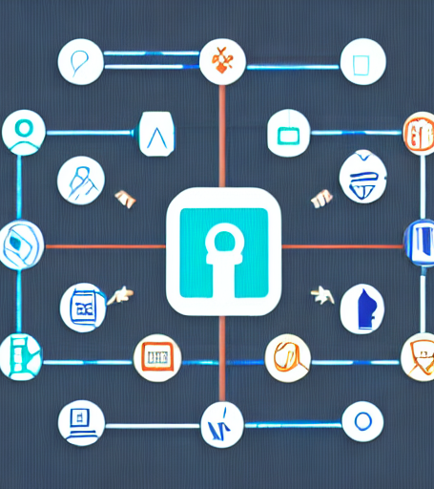
Role Based Access Control
Role Based Access Control RBAC limits system access by assigning users to predefined roles each with specific permissions
Assign roles based on job responsibilities
Enforce least-privilege access
Simplify permission management
Enable audit and compliance

Slide 17
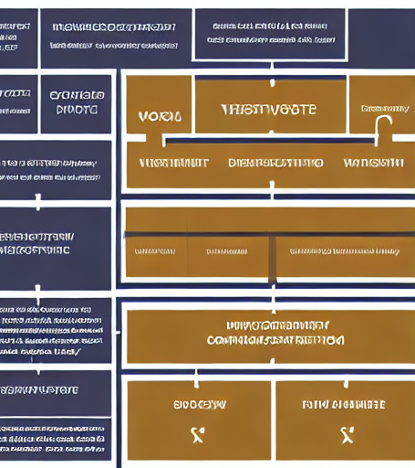
Vulnerability Management Workflow
Vulnerability management workflow is a systematic process for identifying evaluating and mitigating security weaknesses in web applications ensuring continuous protection by prioritizing threats and tracking remediation status
Scan web apps for known vulnerabilities
Assess risk based on impact and likelihood
Prioritize fixes using risk scoring
Track remediation until closure

Slide 18

Third Party Component Security
Thirdparty component security ensures that external libraries frameworks and plugins integrated into web applications are safe uptodate and free from known vulnerabilities
Regularly update and patch all external dependencies
Use automated vulnerability scanners for component checks
Implement strict license compliance and provenance verification
Enforce runtime controls to limit component impact

Slide 19

Mobile Web Application Security
Mobile web applications deliver content to mobile devices via browsers requiring specialized security controls to protect data ensure integrity and maintain secure connections
Use HTTPS to encrypt data in transit
Validate and sanitize all user inputs
Implement secure authentication and token storage
Regularly update mobile libraries and frameworks

Slide 20

Cloud Hosting Security Considerations
Cloud hosting leverages shared infrastructure to deploy web applications Security requires managing shared responsibility data isolation and provider controls
Assess providers security certifications and compliance frameworks
Implement strong identity and access management controls
Encrypt data at rest and in transit
Regularly audit logs and monitor for anomalous activity

Slide 21
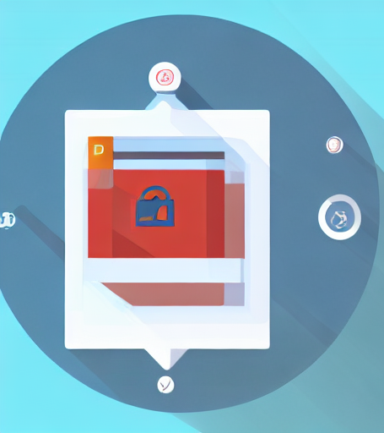
Regulatory Compliance Requirements
Regulatory compliance ensures web applications meet legal and industry standards for data protection
Adhere to GDPR for EU user data privacy
Implement PCI-DSS to secure payment card information
Follow HIPAA for safeguarding health data
Conduct regular audits and penetration tests

Slide 22
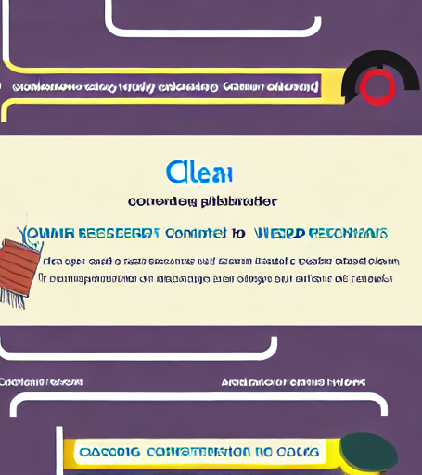
Incident Response Planning
Incident response planning outlines steps to detect contain eradicate and recover from web application security incidents
Establish clear incident detection indicators
Define roles and responsibilities
Create containment and eradication procedures
Plan communication and postincident analysis

Slide 23

Business Continuity and Recovery
Business continuity and recovery keep web applications available and protect data after disruptions
Identify critical application components
Implement redundant hosting and failover
Automate backup and restore testing
Establish clear incident response playbooks

Slide 24

Security Awareness Training
Security awareness training educates users on safe practices and threat recognition to protect web applications
Recognize phishing emails and suspicious links
Use strong unique passwords and enable MFA
Report security incidents promptly to the IT team
Regularly update software and apply security patches

Slide 25

Monitoring and Detection Tools
Monitoring and detection tools continuously analyze web traffic logs and system metrics to enable rapid identification of anomalies and potential attacks
Realtime traffic analysis for instant threat identification
Log aggregation to correlate events across services
Automated alerts for suspicious behaviors
Dashboards visualize attack trends and metrics

Slide 26

Future Trends in Web Security
Future trends in web security are emerging technologies and strategies that will shape the next generation of protecting web applications from evolving threats
Zero Trust architecture gains mainstream adoption
AI driven threat detection becomes standard
Edge computing security models rise
Quantum resistant cryptography is integrated

Slide 27

Building a Secure Culture
A secure culture ensures every team member practices security proactively
Continuous training builds awareness and skill for secure coding
Leadership models security rewarding proactive risk mitigation
Clear policies provide guidelines and enforce consistent practices
Regular audits surface gaps and guide improvement

Slide 28
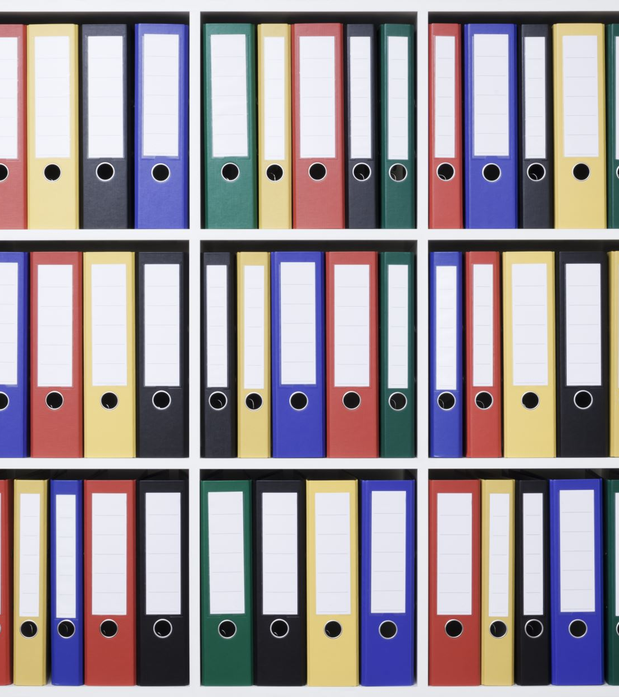
Best Practices Checklist
A structured list of actions and checks that ensure web applications meet security standards It covers authentication input validation secure configuration and ongoing monitoring
Use strong multifactor authentication
Validate and sanitize all user inputs
Encrypt data at rest and in transit
Regularly update libraries and dependencies

Slide 29

Summary and Takeaways
Web application security protects online systems from attacks such as SQL injection XSS and other coderelated threats encompassing secure coding threat modeling and continuous monitoring
Secure coding practices reduce common vulnerabilities
Regular vulnerability scanning identifies weaknesses early
Employ WAFs to block malicious traffic
Continuous monitoring ensures rapid incident response

